Slide 1
Classification 3
Decision Trees
Random Forest
Gradient Boosting

Slide 2
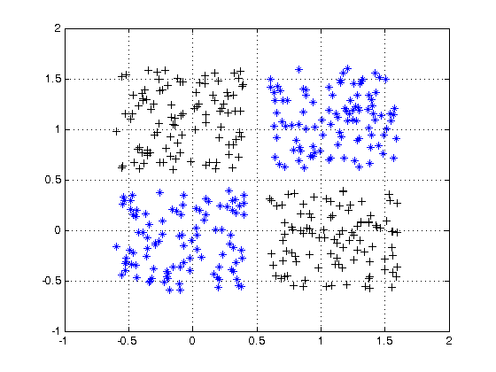
What’s wrong with linear algorithms?
Can’t handle categorical data without encoding
Can’t correctly handle missing data
Simplicity of the model. Each feature is assumed to make a linear contribution to the target variable

Slide 3
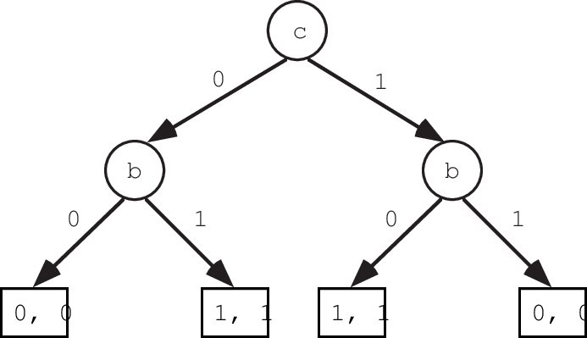

Binary tree
There is predicate for each inner node of the tree:
$β_{v}: χ →\{0, 1\}$
Each leaf node contains prediction ща еру ащкь:
$С_{v}$
We will take in account only simple predicates:
$$β_{v}\left(x;j,t\right)=[x_{j}<t]$$

Slide 4
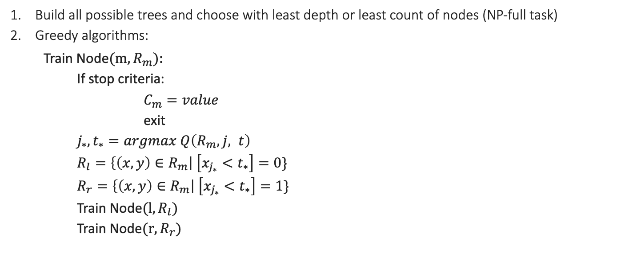
How to train binary trees?
Build all possible trees and choose with least depth or least count of nodes (NP-full task)
Greedy algorithms:
Train Node$(m, R_{m}):$
If stop criteria:
$C_{m}=value$
exit
$j_{∗}, t_{∗}=argmax Q\left(R_{m}, j, t\right)$
$R_{l}=\left\{\left(x, y\right)∈R_{m}\right| \left[x_{j_{∗}}<t_{∗}\right]=0\}$
$R_{r}=\left\{\left(x, y\right)∈R_{m}\right| \left[x_{j_{∗}}<t_{∗}\right]=1\}$
Train Node$(l, R_{l})$
$\text{Train} \text{Node}(r, R_{r})$

Slide 5
What should we clarify?
Quality functional
Stop criterions
Trees pruning
Handling of missing data

Slide 6
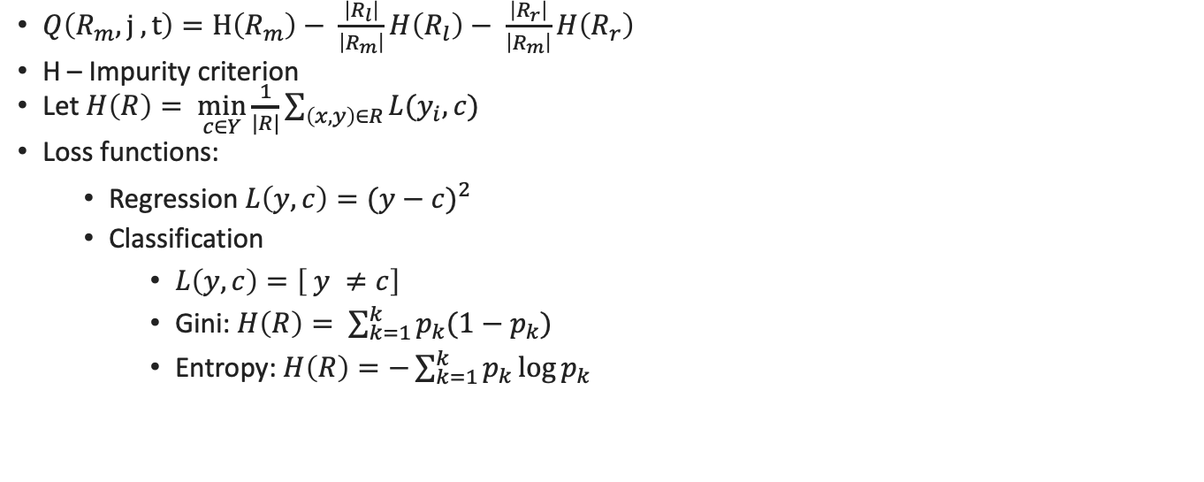
Quality Functional
$Q\left(R_{m}, j , t\right)=H\left(R_{m}\right)− \frac{\left|R_{l}\right|}{\left|R_{m}\right|}H\left(R_{l}\right)− \frac{\left|R_{r}\right|}{\left|R_{m}\right|}H\left(R_{r}\right)$
H – Impurity criterion
Let $H\left(R\right)= \min_{c∈Y}{\frac{1}{|R|}\sum_{\left(x,y\right)∈R}{L(y_{i}, c)}}$
Loss functions:
Regression $L\left(y, c\right)={(y−c)}^{2}$
Classification
$L\left(y, c\right)=\left[ y ≠c\right]$
Gini: $H\left(R\right)= \sum_{k=1}^{k}{p_{k}(1−p_{k})}$
Entropy: $H\left(R\right)=−\sum_{k=1}^{k}{p_{k}\log{p_{k}}}$

Slide 7
Pruning
Pre-pruning: change the stop criterion before start of the process: i.e. tree depth or setting the minimum threshold for splitting according to the quality functional. It is considered more efficient because it does not require full training, and immediately the tree remains smaller. But the problem of the horizon is also understandable: due to the strict stopping criterion, there may be underfitting.
Post-pruning: replace internal nodes and / or subtrees with leaf nodes. Shrink the tree slightly but may result in better generalizing ability of the model. There are two main methods:
Down up. We start from the lower nodes, check the quality of the model without the presence of a node, and if it does not change, then the node is changed to a leaf or removed. Subtrees are not removed like this.
Top down. We start at the root of the tree. A quality check is performed, if the quality does not deteriorate, then the node and the entire subtree, if any, are deleted and replaced with a leaf

Slide 8
Handling missing values
the gaps can be processed as a weighted average of the forecasts of both nodes where the object should have been placed into when decision by the missing attribute is taken place, where the weights are the percentage of objects that fell into each of the nodes laying below
The second way is to use surrogate predicates. At each node, two features are selected that produce the closest partitions to each other.
But it is no less efficient to replace missing numerical values with some very large numbers, which can easily allow the predicate to cut off all objects with gaps

Slide 9
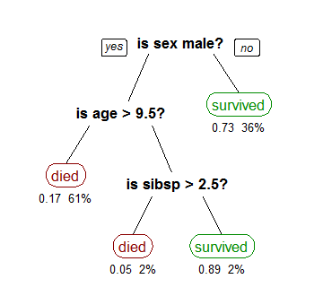
Decision tree: Titanic
pclass | survived | sex | age | siblings spouses | parents children
1 | 1 | female | 29 | 0 | 0
2 | 1 | female | 34 | 1 | 1
1 | 1 | female | 3 | 1 | 2
1 | 0 | male | 30 | 1 | 2
1 | 0 | female | 25 | 1 | 2
3 | 0 | male | 45 | 0 | 0
1 | 1 | female | 63 | 1 | 0

Slide 10
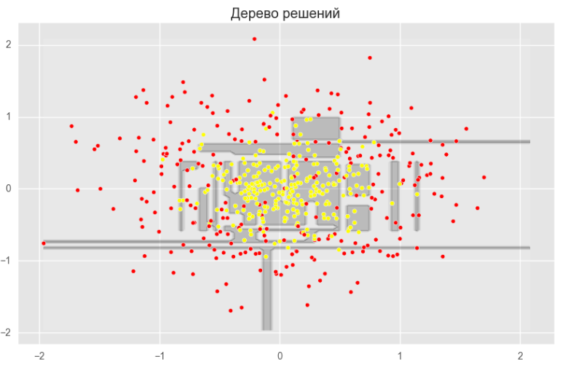
Advantages and disadvantages of trees
Pros:
Human friendly splits
Fast training
Easy to visualize
Cons:
Easy to overfit
Lot of train params
Difficult balance
Unstable behavior to changes in incoming data

Slide 11
Ensembles of models
BaGGING (Random Forest)
Boosting (Boosting trees)
Choose the one method
N models are trained on bootstrapped subsamples of dataset
The final prediction is averaged across all models.
Bias isn’t change
The variance will decrease the more the less correlated the base models.
Choose the base train method
N models are trained in such way that each next one corrects the errors of the previous one.
Base models should be simple enough
Final answer is the sum of the answers for all models
Bias will decrease
Variance will also decrease

Slide 12
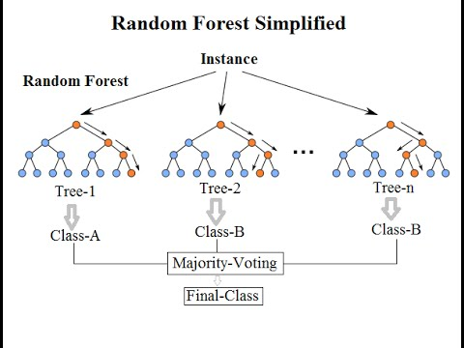
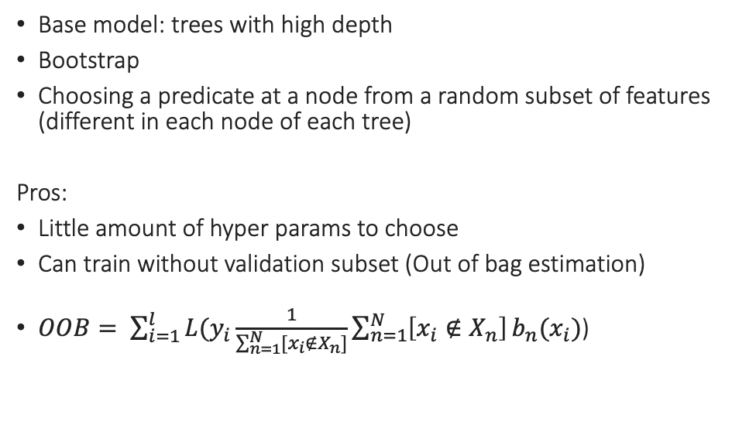
Random Forest
Base model: trees with high depth
Bootstrap
Choosing a predicate at a node from a random subset of features (different in each node of each tree)
Pros:
Little amount of hyper params to choose
Can train without validation subset (Out of bag estimation)
$OOB= \sum_{i=1}^{l}{L(y_{i}\frac{1}{\sum_{n=1}^{N}{{[x}_{i}}∉X_{n}]}\sum_{n=1}^{N}{\left[x_{i}∉X_{n}\right]}b_{n}(x_{i})}$)

Slide 13
Cons of Random Forest
Takes a lot of resources to train the model
Every single tree ”doesn’t know” anything about previous trees

Slide 14
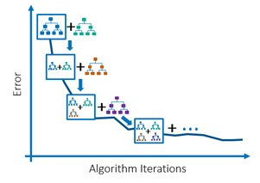
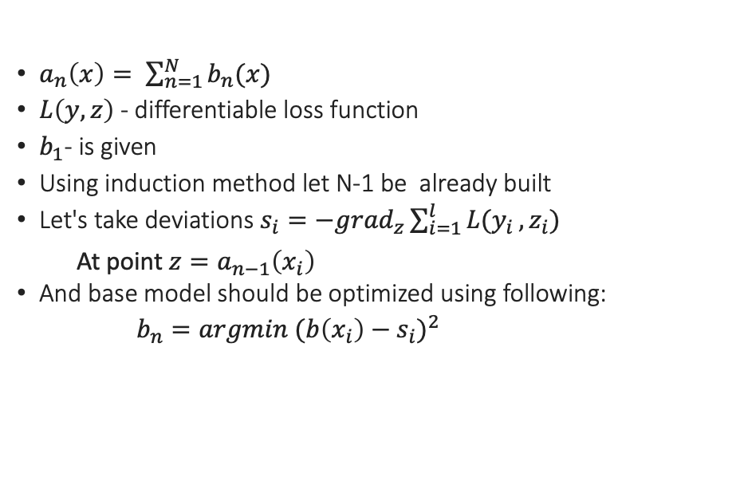
Gradient boosting
$a_{n}\left(x\right)= \sum_{n=1}^{N}{b_{n}(x)}$
$L\left(y, z\right)$ - differentiable loss function
$b_{1}$- is given
Using induction method let N-1 be already built
Let's take deviations $s_{i}=−{grad}_{z}\sum_{i=1}^{l}{L(y_{i}}, z_{i})$
At point $z=a_{n−1}\left(x_{i}\right)$
And base model should be optimized using following:
$b_{n}=argmin {(b\left(x_{i}\right)−s_{i})}^{2}$

Slide 15
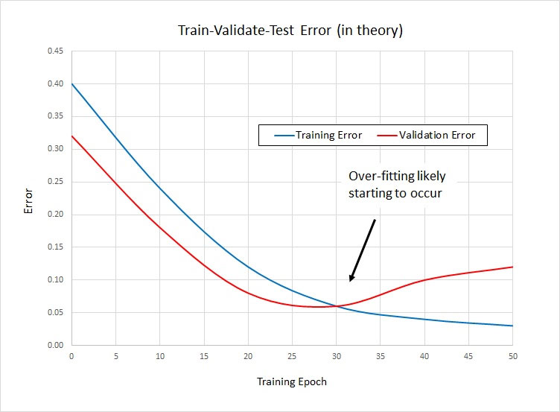
Gradient boosting
Pros:
Versatility
Cons:
Need to be trained on big amount of data
Poor results with a large volume of features that interact closely with each other
Overfitting is possible
Risks:
Basic models that are too simple
Basic models that are too complex
Decisions:
Learning rate
SGD

Slide 16
What else
Boosting over trees and optimizing leaf predictions
Weighting objects (ADABOOST)
Different implementation and theirs differeneces : XGBoost, LightGBM, CatBoost

Slide 17
Q&A

